Slide 1


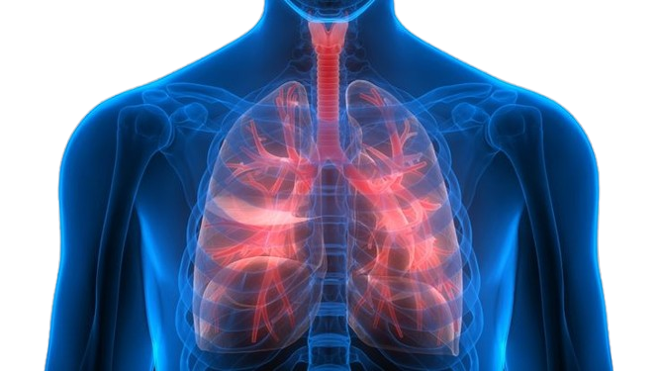

Scarred Lungs, Stolen Breath:
Understanding Pulmonary Fibrosis

Slide 2

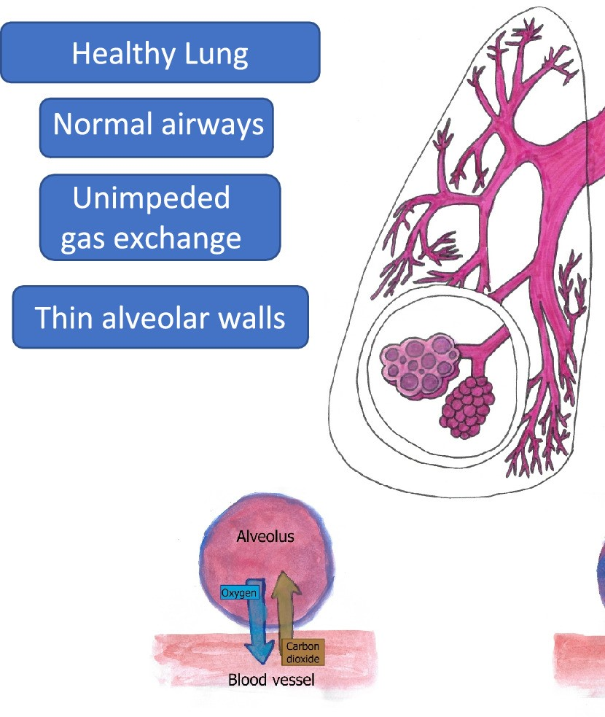
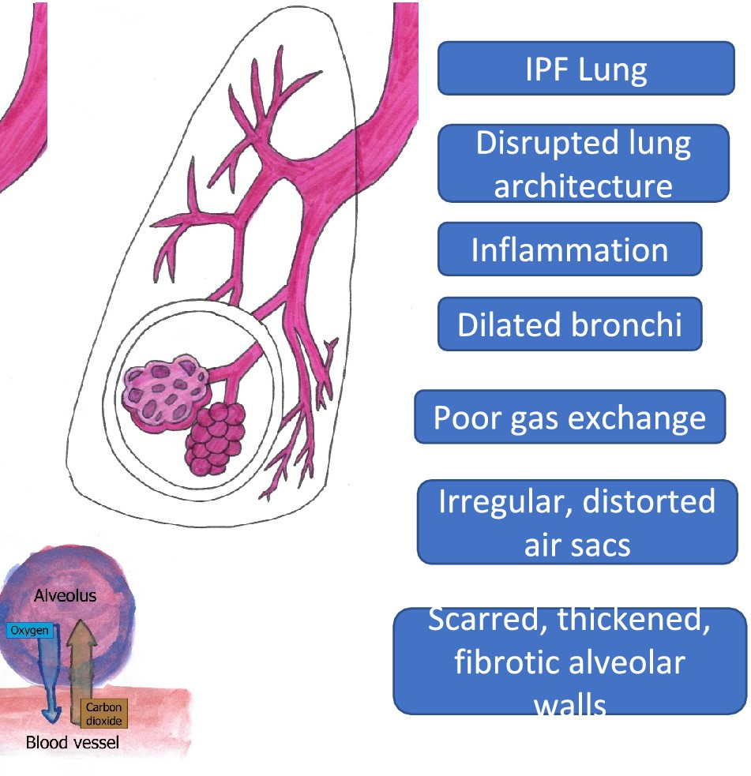
Section 1: What is Pulmonary Fibrosis?
Idiopathic pulmonary fibrosis (IPF) is an interstitial lung disease (ILD), which is characterized by disease progression and functional decline. [1]
Healthy lung
Fibrotic lung

Slide 3
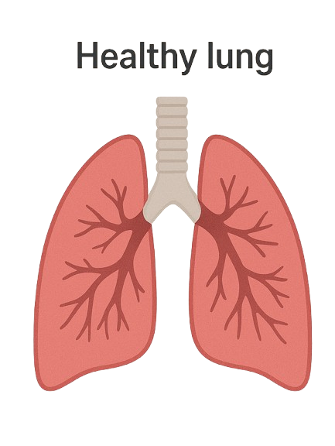
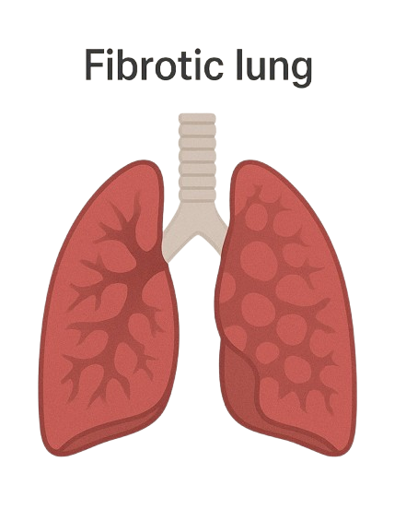
Section 1: What is Pulmonary Fibrosis?
Comparing a healthy lung to an infected lung

Slide 4
Section 2: How It Disrupts Oxygen Delivery
Step 1
Air enters the alveoli
Step 2
Scar tissue thickens walls
Step 3
Oxygen
Diffuses
Step 4
Tissues become hypoxic
Step by step process on how pulmonary fibrosis disrupts oxygen delivery

Slide 5




Section 3: Causes
The causes of IPF remain unknown [1]

Slide 6





Section 4: Symptoms[1]
Shortness of breath
Fatigue
Chest discomfort
Dry cough

Slide 7

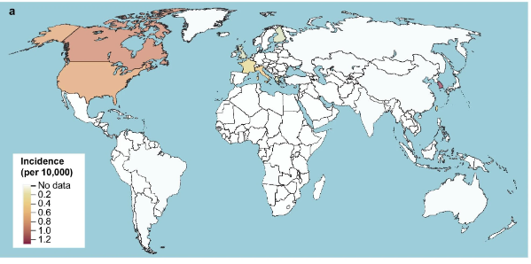
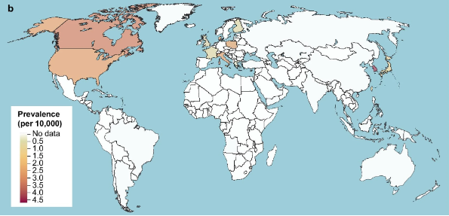
Section 5: Facts & Figures
Incidence and Prevalence [2]
range of 0.09–1.30 and 0.33–4.51 per 10,000 persons, respectively
There are high incidences in North America
Incidences are moderate in Europe
Japan also has a notable value.
South Korea has the highest prevalence
Its moderate in Europe
Its also high in north America

Slide 8
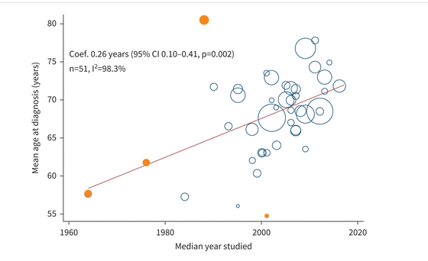
Section 5: Facts & Figures
Mean age at diagnosis[5]
Study covers years 1960- 2020
Diagnosis age increases over time

Slide 9
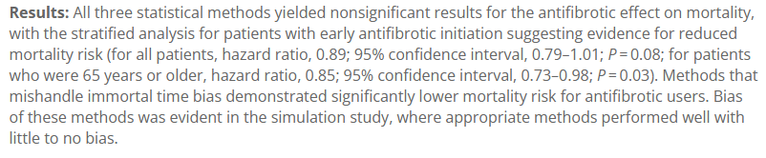
Section 5: Facts & Figures
Antifibrotic effect on mortality [4]
Early treatment shows low mortality
There is a stronger effect in older patients

Slide 10
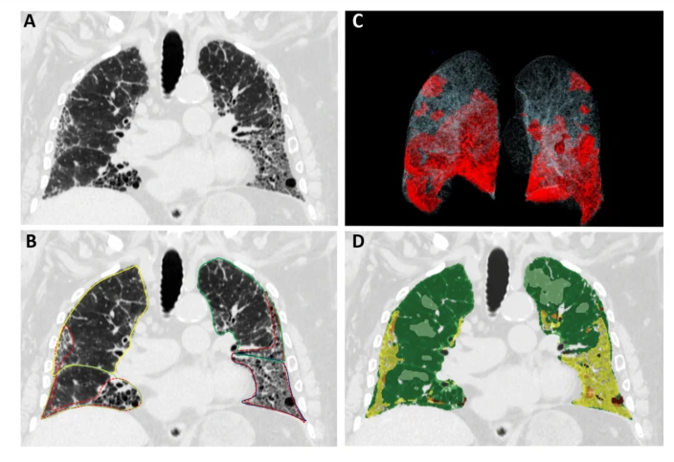
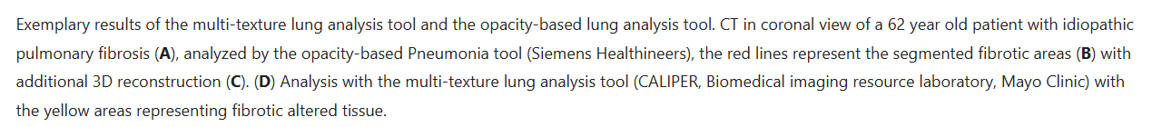
Section 5: Facts & Figures
Opacity based quantification of fibrosis [3]
Green area indicates healthier tissues
Gray area shows healthy tissues
Shows the baseline images for comparison

Slide 11


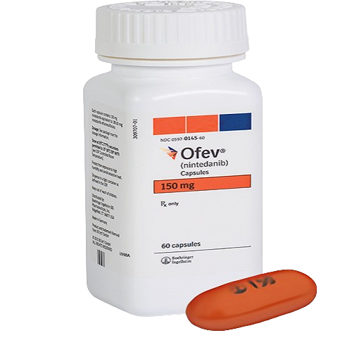
Section 6: Management & Solutions
oral antifibrotic drugs
Pirfenidone
Nintedanib

Slide 12

Section 7: References
Glass, D. S., Grossfeld, D., Renna, H. A., Agarwala, P., Spiegler, P., DeLeon, J., & Reiss, A. B. (2022). Idiopathic pulmonary fibrosis: Current and future treatment. The Clinical Respiratory Journal, 16(2), 84–96. https://doi.org/10.1111/crj.13466
Maher, T. M., Bendstrup, E., Dron, L., Langley, J., Smith, G., Khalid, J. M., Patel, H., & Kreuter, M. (2021). Global incidence and prevalence of idiopathic pulmonary fibrosis. Respiratory Research, 22(1), 197. https://doi.org/10.1186/s12931-021-01791-z
Nowak, S., Creuzberg, D., Theis, M., Pizarro, C., Isaak, A., Pieper, C. C., Luetkens, J. A., Skowasch, D., Sprinkart, A. M., & Kütting, D. (2025). Comparing multi-texture fibrosis analysis versus binary opacity-based abnormality detection for quantitative assessment of idiopathic pulmonary fibrosis. Scientific Reports, 15(1), 1479. https://doi.org/10.1038/s41598-025-85135-7
Xu, H., Hui, S. L., Lee, J. S., Zhang, Z., & Boente, R. D. (2024). Effect of Antifibrotic Use on Mortality in Patients with Idiopathic Pulmonary Fibrosis. Annals of the American Thoracic Society, 21(10), 1407–1415. https://doi.org/10.1513/AnnalsATS.202312-1054OC
Zheng, Q., Cox, I. A., Campbell, J. A., Xia, Q., Otahal, P., De Graaff, B., Corte, T. J., Teoh, A. K. Y., Walters, E. H., & Palmer, A. J. (2022). Mortality and survival in idiopathic pulmonary fibrosis: A systematic review and meta-analysis. ERJ Open Research, 8(1), 00591–02021. https://doi.org/10.1183/23120541.00591-2021

